Slide 1
Unit-1 Introductory concepts of DBMS
Database Management Systems (DBMS)

Slide 2

Looping
Outline
Introduction of DBMS
Applications of DBMS
Advantages of DBMS
Three levels ANSI SPARC database system
Data Abstraction in DBMS
Mappings and data independence
Database users and DBA
Database system architecture

Slide 3
Introduction to DBMS
Section - 1

Slide 4
What is Database Management System (DBMS)?
Data - Fact that can be recorded or stored
e.g. Person Name, Age, Gender and Weight etc.
Database - Collection of logically related data
e.g. Books Database in Library, Student Database in University etc.
Management - Manipulation, Searching and Security of data
e.g. Viewing result in GTU website, Searching exam papers in GTU website etc.
System - Programs or tools used to manage database
e.g. SQL Server Studio Express, Oracle etc.
DBMS - A Database Management System is a software for creating and managing databases.
Database Management System (DBMS) is a software designed to define, manipulate, retrieve and manage data in a database.
e.g. MS SQL Server, Oracle, My SQL, SQLite, MongoDB etc.

Slide 5
Applications of DBMS
Section - 2

Slide 6
Applications of DBMS
DBMS is a computerized record-keeping system.
DBMS is required where ever data need to be stored.
E-Commerce (Flikart, Amazon, Shopclues, eBay etc...)
Online Television Streaming (Hotstar, Amazon Prime etc...)
Social Media (WhatsApp, Facebook, Twitter, LinkedIn etc...)
Banking & Insurance
Airline & Railway
Universities and Colleges/Schools
Library Management System
Human Resource Department
Hospitals and Medical Stores
Government Organizations
Exercise
Write down any five applications of DBMS other than above.

Slide 7
Advantages of DBMS
Section - 3

Slide 8

Reduce data redundancy (duplication)
Computer
Civil
Emp_Name | Address | Mobile | Subject
Emp_Name | Address | Mobile | Subject
Prof. john wick | Newyork | 1234 | DBMS
Prof. john wick | Newyork | 1234 | DBMS
Database management system can remove such data redundancy by storing data centrally.
Same data is stored at
four different places.
Emp_Name | Address | Mobile | Subject
Emp_Name | Address | Mobile | Subject
Prof. john wick | Newyork | 1234 | DBMS
Prof. john wick | Newyork | 1234 | DBMS
Electrical
Mechanical

Slide 9
Remove data inconsistency
Computer
Civil
Emp_Name | Address | Mobile | Subject
Emp_Name | Address | Mobile | Subject
6789
Prof. john wick | Newyork | 1234 | DBMS
Prof. john wick | Newyork | 1234 | DBMS
Database management system can keep data in consistent state.
Same data having
different state (values)
Mobile no is changed
Emp_Name | Address | Mobile | Subject
Emp_Name | Address | Mobile | Subject
6789
Prof. john wick | Newyork | 1234 | DBMS
Prof. john wick | Newyork | 1234 | DBMS
Electrical
Mechanical

Slide 10
Data isolation
Data are scattered in various files.
Files may be in different formats.
Difficult to retrieve the appropriate data.
File - 1
Emp_Name | Address | Mobile | Subject
Prof. john wick | Newyork | 1234 | DBMS
DBMS allow us to access (retrieve) appropriate data easily.
File - 2
Emp_Name | Post | Salary | Load
Prof. john wick | Lecturer | 50,000 | 15
Data isolation is a property that determines when and how changes made by one operation become visible to other concurrent users and systems.
This issue occurs in a concurrency situation.
File - 3
Emp_Name | Teaching | Knowledge | Rating
Prof. john wick | Good | Excellent | 9

Slide 11


Guaranteed atomicity
Atomicity: Either transaction execute 0% or 100%.
Sum of both account before transfer is 3000
Person A
Account A
Bal : 2000
Transfer 500
Person B
Account B
Bal : 1000
Step 1 : Debit 500 from Account A
Step 2 : Credit 500 into Account B
Transaction is failed
Sum of both account is 2500
so inconsistent
Sum of both account
after transfer is 3000

Slide 12
Allow to implement integrity constraints
Emp_Name | Address | Mobile_No | Subject
Prof. john wick | Newyork | 9876543210 | DBMS
Should contain exact 10 digits
Student_Name | Branch | Backlog | SPI
Nirav Patel | Newyork | 0 | 8.5
Should be between 0 to 10
DBMS allows us to implement such business rules in our database..

Slide 13

Sharing of data among multiple users
Want to access
Computer
Civil
Emp_Name | Address | Mobile | Subject
Emp_Name | Address | Mobile | Subject
Prof. john wick | Newyork | 1234 | DBMS
Prof. john wick | Newyork | 1234 | DBMS
Want to access
Database management system allows more than one user to access same data simultaneously.
Emp_Name | Address | Mobile | Subject
Emp_Name | Address | Mobile | Subject
Prof. john wick | Newyork | 1234 | DBMS
Prof. john wick | Newyork | 1234 | DBMS
Electrical
Mechanical

Slide 14

Restricting unauthorized access to data
File - 1
Emp_Name | Address | Mobile | Subject
Prof. john wick | Newyork | 1234 | DBMS
Wants to access
Faculty of other college
File - 2
Emp_Name | Post | Salary | Load
Prof. john wick | Lecturer | 50,000 | 15
Wants to access
Darshan Faculty
File - 3
Emp_Name | Teaching | Knowledge | Rating
Prof. john wick | Good | Excellent | 9
DBMS prevents unauthorized user to access data.

Slide 15
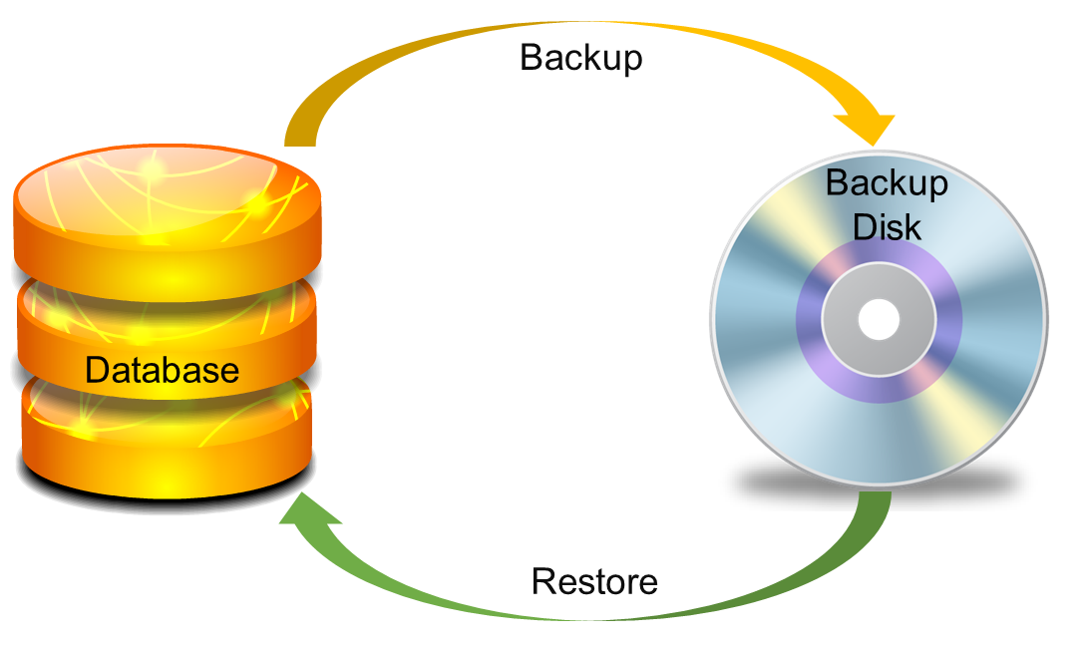
Providing backup and recovery services
Provides facilities to backup and restore the database in case of failure.

Slide 16
Advantages of DBMS (Summary)
Reduce data redundancy (duplication)
Avoids unnecessary duplication of data by storing data centrally.
Remove data inconsistency
By eliminating redundancy, data inconsistency can be removed.
Data isolation
A user can easily retrieve proper data as per his/her requirement.
Guaranteed atomicity
Either transaction executes 0% or 100%.

Slide 17
Advantages of DBMS (Summary)
Allow implementing integrity constraints
Business rules can be implemented such as do not allow to store amount less than Rs. 0 in balance.
Sharing of data among multiple users
More than one users can access same data at the same time.
Restricting unauthorized access to data
A user can only access data which is authorized to him/her.
Providing backup and recovery services
Can take a regular auto or manual backup and use it to restore the database if it corrupts.

Slide 18
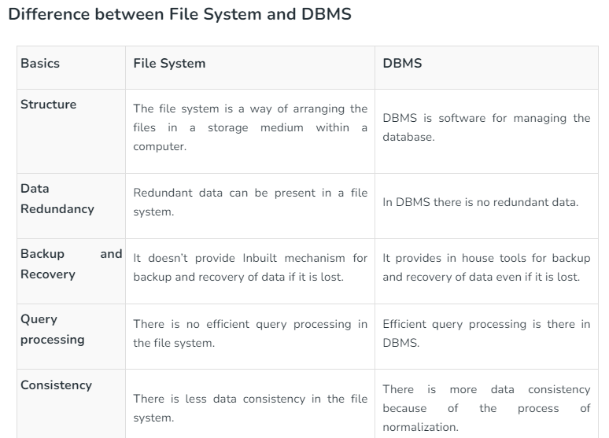
File Versus a DBMS

Slide 19
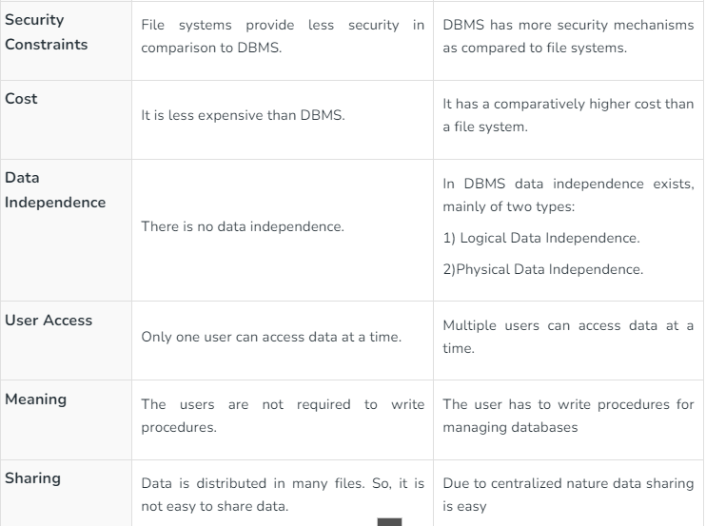

Slide 20
Basic Terms
Section - 4

Slide 21
Basic terms
Data
Data is raw, unorganized facts that need to be processed.
Example: Marks of students
Student_1 = 50/100, Student_2 = 25/100.
Information
When data is processed, organized, structured or presented in a given context so as to make it useful, it is called information.
Example: Result of students (Pass or Fail)
Student_1 = Pass, Student_2 = Fail.

Slide 22
Basic terms (cont…)
Metadata
Metadata is data about data.
Data such as table name, column name, data type, authorized user and user access privileges for any table is called metadata for that table.
Metadata of above table is:
Table name such as Faculty
Column name such as Emp_Name, Address, Mobile_No, Subject
Datatype such as Varchar, Decimal
Access privileges such as Read, Write (Update)
Faculty
Emp_Name | Address | Mobile_No | Subject
Prof. john wick | Newyork | 9876543210 | DBMS

Slide 23
Basic terms (cont…)
Data dictionary
A data dictionary is an information repository which contains metadata.
Data warehouse
A data warehouse is an information repository which stores data.
Table Name – Faculty
Column Name – EmpName, Address, Mob, Subject, Salary
Datatype – Varchar, Decimal
Access Privileges – Read, Write (Update)
Faculty
Emp_Name | Address | Mobile_No | Subject
Prof. john wick | Newyork | 9876543210 | DBMS
Prof. Ajay Patel | Surat | 0123456789 | DBMS
Exercise
Why data dictionary and data warehouse are stored in the different places?

Slide 24
Basic terms (cont…)
Field
A field is a character or group of characters that have a specific meaning.
E.g, the value of Emp_Name, Address, Mobile_No etc are all fields of Faculty table.
Record / Tuple
A record is a collection of logically related fields.
E.g, the collection of fields (Emp_Name, Address, Mobile_No, Subject) forms a record for the Faculty.
Faculty
Emp_Name | Address | Mobile_No | Subject
Prof. john wick | Newyork | 9876543210 | DBMS
Prof. Ajay Patel | Surat | 0123456789 | DBMS
Fields
Prof. john wick
Newyork
9876543210
Prof. john wick | Newyork | 9876543210 | DBMS
Record / Tuple
Prof. Ajay Patel | Surat | 0123456789 | DBMS

Slide 25
3 Levels Database System
Section - 5

Slide 26

3 Levels Database System
User 1
User 2
User 3
How data are viewed by each users?
View 1
View 2
View 3
View
Level
What data are stored and
What relationships exist?
Conceptual
Level
Logical
Level
How the data are actually stored on storage devices?
Internal
Level
Physical
Level
Database

Slide 27
3 Levels ANSI SPARC Database System
Internal level (Physical level)
It describes how a data is stored on the storage device.
Deals with physical storage of data.
Structure of records on disk - files, pages, blocks and indexes and ordering of records
Internal view is described by the internal schema.
Conceptual level (Logical level)
What data are stored and what relationships exist among those data?
It hides low level complexities of physical storage.
For Example, STUDENT database may contain STUDENT and COURSE tables which will be visible to users but users are unaware about their storage.
Database administrator works at this level to determine what data to keep in the database.
External level (View level)
It describes only part of the entire database that an end user concern or how data are viewed by each user.
Different user needs different views of the database, so there can be many views in a view level abstraction of the database. Used by end users and application programmers.
End users need to access only part of the database rather than the entire database.

Slide 28
3 Levels ANSI SPARC Database System: Example
We are storing student information in a student table.
User 1
User 2
User 3
User just interact with system with the help of GUI.
Users are not aware of how and what the data is stored.
View 1
View 2
View 3
View
Level
Records can be described as fields and attributes along with their data types, their relationship among each other can be logically implemented.
Programmers generally work at this level.
Conceptual
Level
Logical
Level
Records can be described as blocks of storage (bytes, gigabytes, terabytes etc.) in memory.
These details are often hidden from the programmers.
Internal
Level
Physical
Level
Database

Slide 29
Data Abstraction in DBMS
Database systems are made-up of complex data structures.
To ease the user interaction with database, the developers hide internal irrelevant details from users.
This process of hiding irrelevant details from user is called data abstraction.

Slide 30
Mapping and Data Independence
Want to access some data
User 1
User 2
User 3
View 1
View 2
View 3
View
Level
Request
Process of transforming requests and results between the three levels is called mapping.
Conceptual
Level
Logical
Level
Ability to modify a schema definition in one level without affecting a schema definition in the next higher level.
Internal
Level
Physical
Level
Result
Database

Slide 31
Types of Data Independence
Physical Data Independence
Physical Data Independence is the ability to modify the physical schema without requiring any change in logical (conceptual) schema and application programs.
Modifications at the internal levels are occasionally necessary to improve performance.
Possible modifications at internal levels are changes in file structures, compression techniques, hashing algorithms, storage devices, etc.
Logical Data Independence
Logical data independence is the ability to modify the conceptual schema without requiring any change in application programs.
Modification at the logical levels is necessary whenever the logical structure of the database is changed.
Application programs are heavily dependent on logical structures of the data they access. So any change in logical structure also requires programs to change.

Slide 32
Types of Database Users
Section - 6

Slide 33
Types of Database Users
Naive Users (End Users)
Unsophisticated users who have zero knowledge of database system
End user interacts to database via sophisticated software or tools
e.g. Clerk in bank
Application Programmers
Programmers who write software using tools such as Java, .Net, PHP etc…
e.g. Software developers
Sophisticated Users
Interact with database system without using an application program
Use query tools like SQL
e.g. Analyst
Specialized Users (DBA)
User write specialized database applications program
Use administration tools
e.g. Database Administrator

Slide 34
Role of DBA (Database Administrator)
Section - 7

Slide 35
Role of DBA
Schema Definition
DBA defines the logical schema of the database.
Storage Structure and Access Method Definition
DBA decides how the data is to be represented in the database & how to access it.
Defining Security and Integrity Constraints
DBA decides on various security and integrity constraints.
Granting of Authorization for Data Access
DBA determines which user needs access to which part of the database.
Liaison with Users
DBA provide necessary data to the user.

Slide 36
Role of DBA
Assisting Application Programmer
DBA provides assistance to application programmers to develop application programs.
Monitoring Performance
DBA ensures that better performance is maintained by making a change in the physical or logical schema if required.
Backup and Recovery
DBA backing up the database on some storage devices such as DVD, CD or magnetic tape or remote servers and recover the system in case of failures, such as flood or virus attack from this backup.

Slide 37
Database System Architecture
Section - 8

Slide 38
Database System Architecture
Naive
user
Application programmer
Sophisticated
user
Database administrator
uses
write
uses
uses
Application
interfaces
Application
program
Query
tool
Administration tool
Translates DML statements into low level instructions that the query evaluation engine understands
Compiler and linker
DML queries
DDL interpreter
Interprets DDL statements into a set of tables containing metadata
Executes low level instructions generated by DML compiler.
Deals with execution of DDL and DML statements
Application program object code
DML compiler and organizer
Query evaluation engine
Query processor
Buffer manager
File manager
Authorization and integrity manager
Transaction manager
Manages allocation of space on disk storage
Storage manager
Fetches data from disk storage to memory for being used
Preserves atomicity and controls concurrency
Provides interface between low-level data stored and application program or queries
Checks the authority of users to access data and integrity constraints
To provide faster access to data items
Indices
Data dictionary
Disk storage
To store user data
Data
Statistical data
To store statistical information about the data
To store metadata

Slide 39
Questions asked in Exam
List and explain the advantages of DBMS over file based system. OR Explain disadvantages of files based system.
Draw and explain 3 level architecture of DBMS.
List and explain different categories/types of database users.
List and explain different tasks/roles/functions/duties of DBA (Database Administrator).
Explain DBMS architecture with block diagram. OR Explain Database System architecture with block diagram.

